Slide 1

WEEK 8 FINAL PRESENTATIONS
BY: Robert Wilkins

Slide 2

Introduction
Hello My Name is Robert Wilkins. I attend DeVry University; the purpose of this Presentation is to show you the process & challenges I’ve came across during this course. The next few slides are covering the challenges , skills and a preview of every course project followed by a Conclusion slide that explains the overall point of this project.

Slide 3
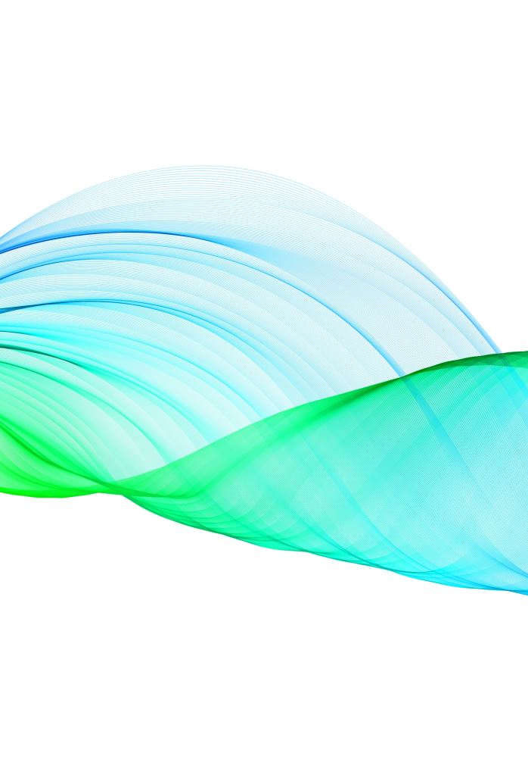
Challenges
Some challenges that were faced during this project are:
Network problems
Coding
Power outages
Non-working apps
Login issues

Slide 4

Skills Obtained
Some skills I’ve obtained from this course is:
Identifying Oscilloscope
Coding / reading the data
Identifying the Spectrum Analyzer
Reading the frequencies
Identifying the signals/ volts of a wavelength
Reading AM Modulations

Slide 5
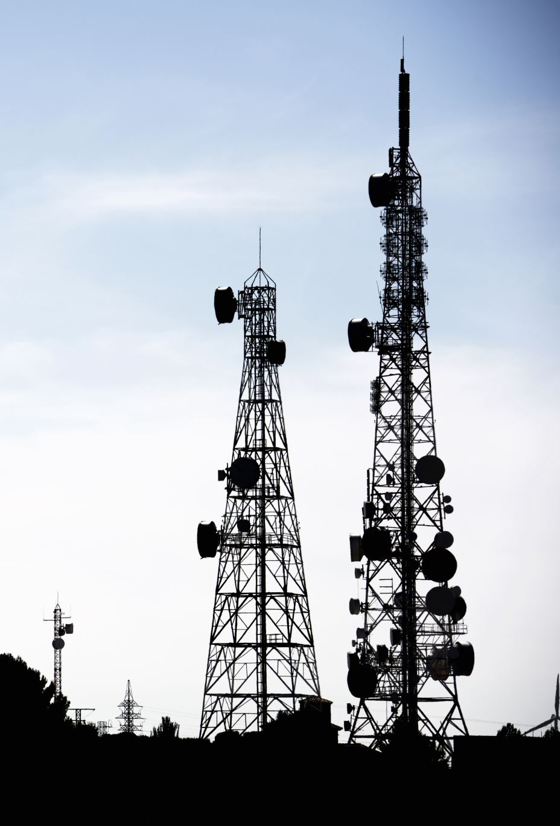
NETW311 Course Project
Module 2
Baseband Signals and AM/FM Signals

Slide 6

Activity | Requirement(s) | Points
Baseband Signals | Take a screenshot | 2
 | Fill in a table | 5
AM Signals | Take three screenshots | 6
 | Fill in a table | 3
 | Develop two equations | 6
FM Signals | Take two screenshots | 4
 | Answer a question | 4
Rubric

Slide 7
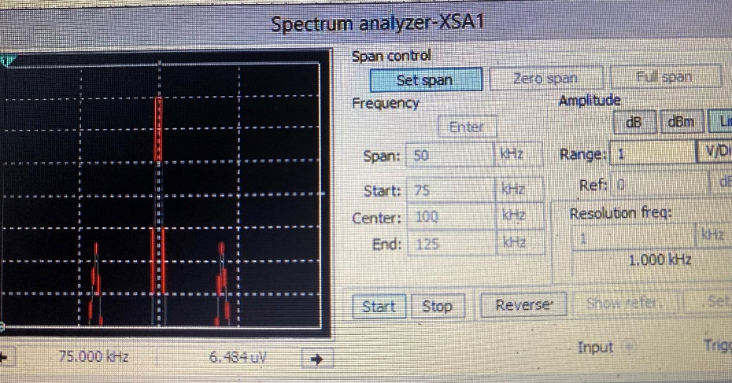
Baseband Signals
The screenshot should show the spectrum analyzer displaying the signal’s harmonic spectrum and its panel settings. Record the signal voltage at each of the frequencies in the table.
SCREENSHOT HERE
Harmonic Frequency | Signal (Volts)
20 kHz | 3.131v
40 kHz | 2.543V
60 kHz | 868,868.9mV
80 kHz | 7.656v
100 kHz | 414.693mV

Slide 8

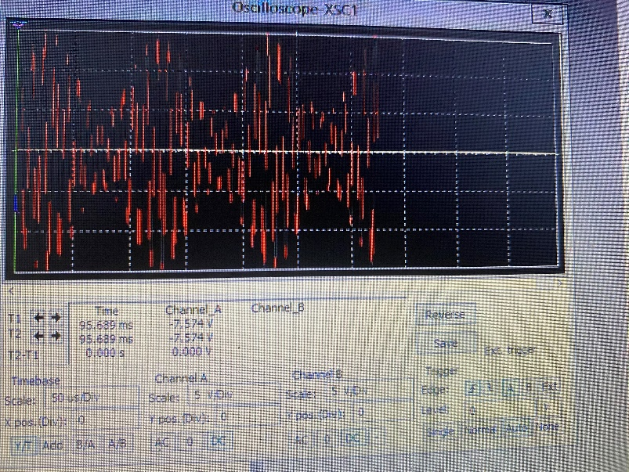
The screenshot of the Oscilloscope should include the signal and the panel settings of the oscilloscope. The screenshot of the Spectrum Analyzer should include the signal and the panel setting of the analyzer.
AM Signals
Oscilloscope screenshot here
Spectrum Analyzer screenshot here
AM Modulation | Frequency (kHz)
Lower side band | 90
Carrier | 100
Upper side band | 110

Slide 9
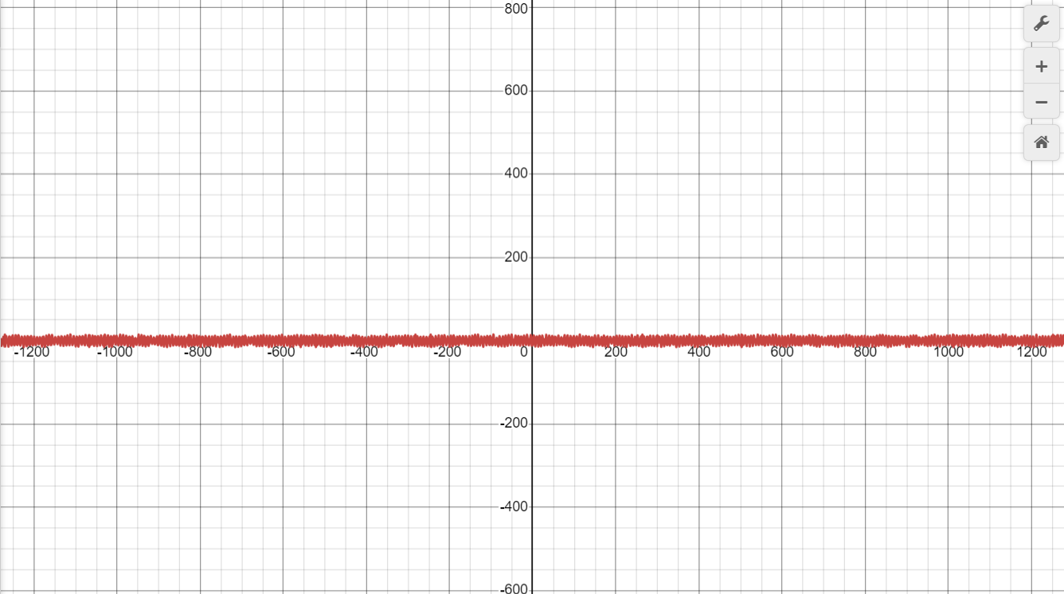
AM Signals Cont.
Develop equations for the carrier and modulating signals and plot the equation for the composite modulated signal V_{AM .}
Equations here:
Fc=100 KHz and fi = 10 KHz
𝑣𝐴𝑀 = 10sin(2𝜋𝑓𝑐𝑡) + 5 sin(2𝜋𝑓𝑖𝑡) *(sin(2𝜋𝑓𝑐𝑡))
Plotted diagram screenshot here:

Slide 10

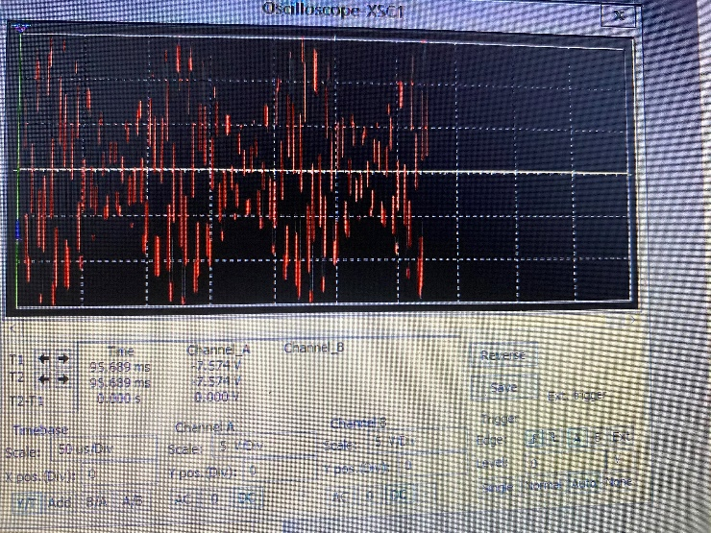
The screenshot of the Oscilloscope should include the signal and the panel settings of the oscilloscope. The screenshot of the Spectrum Analyzer should include the signal and the panel setting of the analyzer.
Oscilloscope screenshot here
Spectrum Analyzer screenshot here
What’s the carrier frequency?
The Carriers Frequency Is 100.
FM Signals

Slide 11

NETW310 Course Project
Module 3
Pulse Code Modulation (PCM) and Line Codes

Slide 12
Activity | Requirement(s) | Points
Pulse Code Modulation (PCM) | Take four screenshots | 40
 | Answer a question | 5
Line Codes | Take one screenshot | 10
 | Answer a question | 5
Rubric

Slide 13
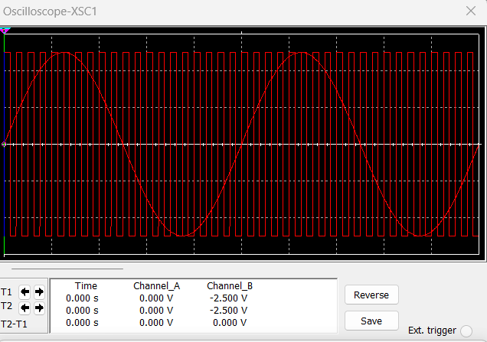
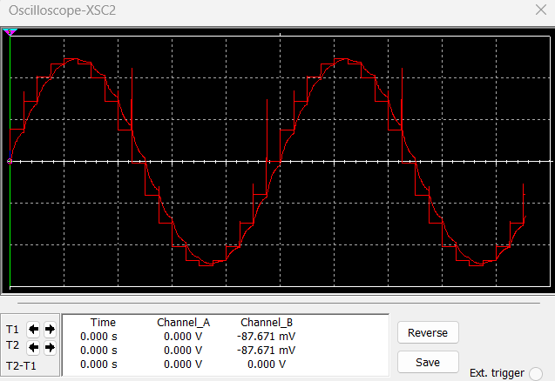
Pulse Code Modulation (PCM)
The first screenshot should show the Oscilloscope-XSC1 display with the analog input signal and sampling clock at the input to the ADC. The second screenshot should show the Oscilloscope-XSC2 display with the output of the DAC.

Slide 14
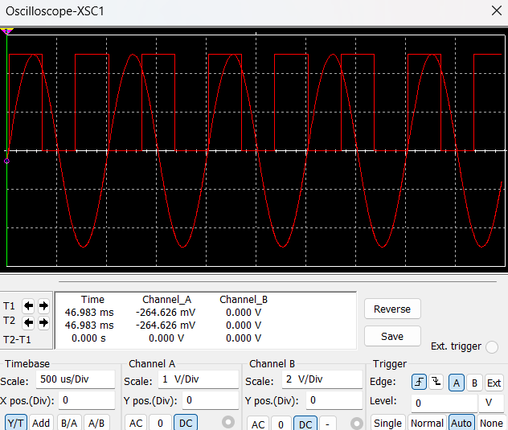
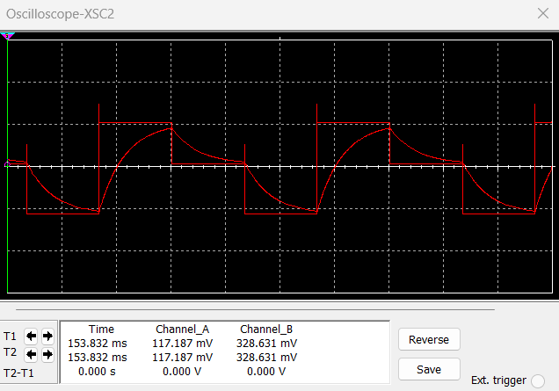
Pulse Code Modulation (PCM)
The first screenshot should show the Oscilloscope-XSC1 display with the analog input signal and sampling clock at the input to the ADC. The second screenshot should show the Oscilloscope-XSC2 display with the output of the DAC.
What are the effects of increasing or decreasing the sampling rate?
Answer: The Sampling rate, often referred to as the sampling frequency, is a crucial factor in digital signal processing that determines how often a continuous signal is sampled to produce a discrete signal.

Slide 15
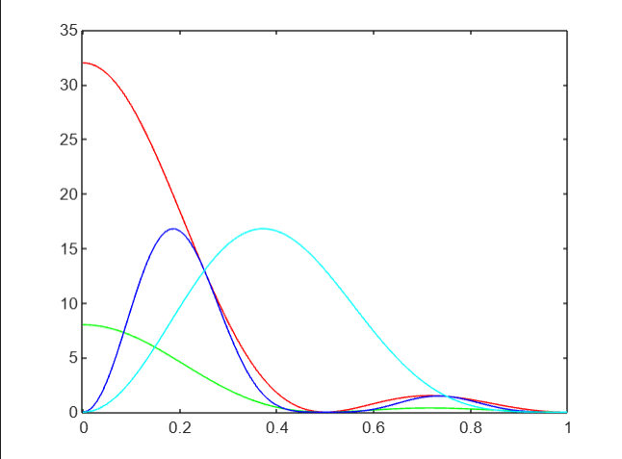
Line Codes
This screenshot should show the power spectral densities of four-line codes: NRZ-Polar, NRZ-Unipolar, NRZ-Bipolar, and Manchester-Polar.
MATLAB Diagram Here
Compare the NRZ-Bipolar and Manchester polar codes in the diagram.
Which one requires more bandwidth?
Answer: Manchester polar encoding requires more bandwidth compared to NRZ Bipolar. This is due to the nature of Manchester encoding, which ensures a transition at every bit period.

Slide 16
NETW310 Course Project
Module 4
Cables and Structured Cabling

Slide 17
Rubric
Activity | Requirement(s) | Points
Cables and Structured Cabling | Answer six questions | 60

Slide 18
Questions
1. Why must the twisting in the individual wires be maintained in a UTP cable?
Answer:
The Twisting in the individual wires of an UTP cable is crucial for minimizing electromagnetic interference, reducing crosstalk, preserving signal integrity, preventing signal reflections.
2. How many inches should UTP cable be separated from 110 volts electrical cable?
Answer:
To minimize interference and ensure safe operation, UTP cables should generally be separated from 110 volts electrical cables by at least 12 inches.
3. Horizontal cabling connects what areas to each other?
Answer:
Horizontal cabling connects the telecommunications rooms or wiring closets to the individual work areas or end user devices within the same floor of a building.

Slide 19
Questions
4. What is a plenum rated cable?
Answer:
A plenum rated cable is a type of cable that is specifically designed to be used in the plenum spaces of a building.
5. What is a riser tube used for?
Answer:
A riser tube or “riser” is used in building infrastructure to facilitate the vertical transportation of various utilities and services between different floors of a building.
6. Is the grounding of equipment mostly a safety or a performance concern?
Answer:
The grounding equipment is primarily a safety concern, but also has significant implications for performance.

Slide 20
NETW310 Course Project
Module 5
Antenna Gain and Free Space Path Loss

Slide 21
Rubric
Activity | Requirement(s) | Points
Antenna Gain | Answer five questions | 22
Free Space Path Loss | Answer nine questions | 38

Slide 22
Antenna Gain
1. What is the maximum theoretical antenna gain of a common dish antenna at the 2.4 GHz band? [4 points]
Answer:
The maximum theoretical gain of a common dish antenna at the 2.4 GHz band is 22.379 dBI
2. What is the maximum theoretical antenna gain of a common dish antenna at the 5 GHz band? [4 points]
Answer:
The maximum theoretical gain of a common dish antenna at the 5 GHz band is 29.079 Dbi.
3. Given the same sized reflector, which signals, high-frequency, or low-frequency, can be more efficiently focused by a common dish antenna (i.e., result in a higher antenna gain)? [5 points]
Answer:
A dish antenna, also known as a parabolic reflector, can more efficiently focus high frequency signals compared to low frequency signals given the same sized reflector.
4. What is the maximum theoretical antenna gain of the dish antenna used in the VLA radio telescopes in New Mexico at the 5 GHz band? [4 points]
Answer: The maximum theoretical antenna gain of an antenna dish used in the VLA radio is 63.059 Dbi.
5. Given the same signal frequency, which dish antennas, large-sized or small-sized, are more efficient at focusing the signal (i.e., result in a higher antenna gain)? [5 points]
Answer: Large sized dish antennas are more efficient at focusing a given frequency signal due to their larger effective aperture, narrower beamwidth, and higher gain.

Slide 23
Free Space Path Loss
1. What is the free space path loss in dB at the 2.4 GHz band? [4 points] Answer:
The free space path loss increases with distance, and the formula can be used to calculate the loss for any given distance at the 2.4GHz band.
2. What is the free space path loss in dB at the 5 GHz band? [4 points] Answer:
The free space path loss increases with distance, and the formula can be used to calculate the loss for any given distance at the 5 GHz band.
3. How does the free space path loss at a higher frequency (e.g., the 5 GHz band) compare with that at a lower frequency (e.g., the 2.4 GHz band)? [5 points]
Answer: The free space path loss (FSPL) increases with frequency. This is because higher frequencies have shorter wavelengths, which results in more rapid attenuation over distance.
4. What is the free space path loss in dB over 20 meters at the 2.4 GHz band? [4 points]
Answer:
Thus, at any given distance, the free space path loss at 5 GHz is consistently 6.376 dB higher than at 2.4 GHz. This difference is solely due to the frequency difference, as higher frequencies have shorter wavelengths, leading to greater loss over the same distance.
5. What is the free space path loss in dB over 40 meters at the 2.4 GHz band? [4 points]
Answer: Therefore, the free space path loss over 40 meters at the 2.4 GHz band is approximately 72.1 dBi.
6. What is the free space path loss in dB over 80 meters at the 2.4 GHz band? [4 points]
Answer: Therefore, the free space path loss over 80 meters at the 2.4 GHz band is approximately 78.1 dBi.
7. When the distance doubles, how does free space path loss in dB change approximately? [5 points]
Answer: So, when the distance doubles, the free space path loss increases by approximately 6 dB.

Slide 24

Free Space Path Loss Cont.
8. Use a scientific calculator to calculate Delta $L_{fS}$ for D1 = 20 meters and D2 = 40 meters. [4 points]
Delta $L_{fS }$= ___________ $L_{fS }$ for D1 =20 Meters
$L_{fS }$ for D2 = 40 meters
The meters are approximately -121.53 & -115.51.
9. Is your calculation approximately the same as the result from Part 1 Step 2? [4 points]
Answer:
Yes, the values are approximately the same.

Slide 25
NETW310 Course Project
Module 6
Bit Error Rate of Fading Channels

Slide 26
Rubric
Activity | Requirement(s) | Points
AWGN Channel and Rician Channel | Take a screenshot | 30
 | Answer a question | 30

Slide 27
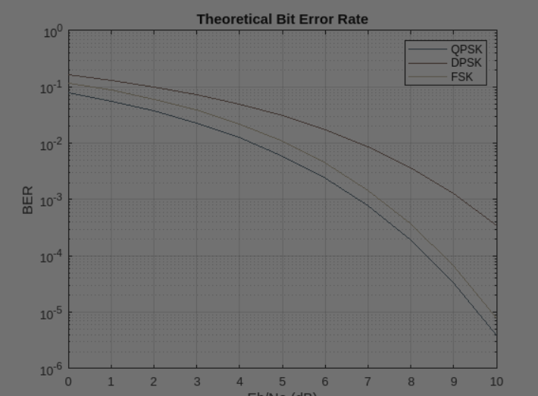
This screenshot should show the bit rate error performance of both AWGN and Rician fading channels.
AWGN Channel and Rician Channel

Slide 28
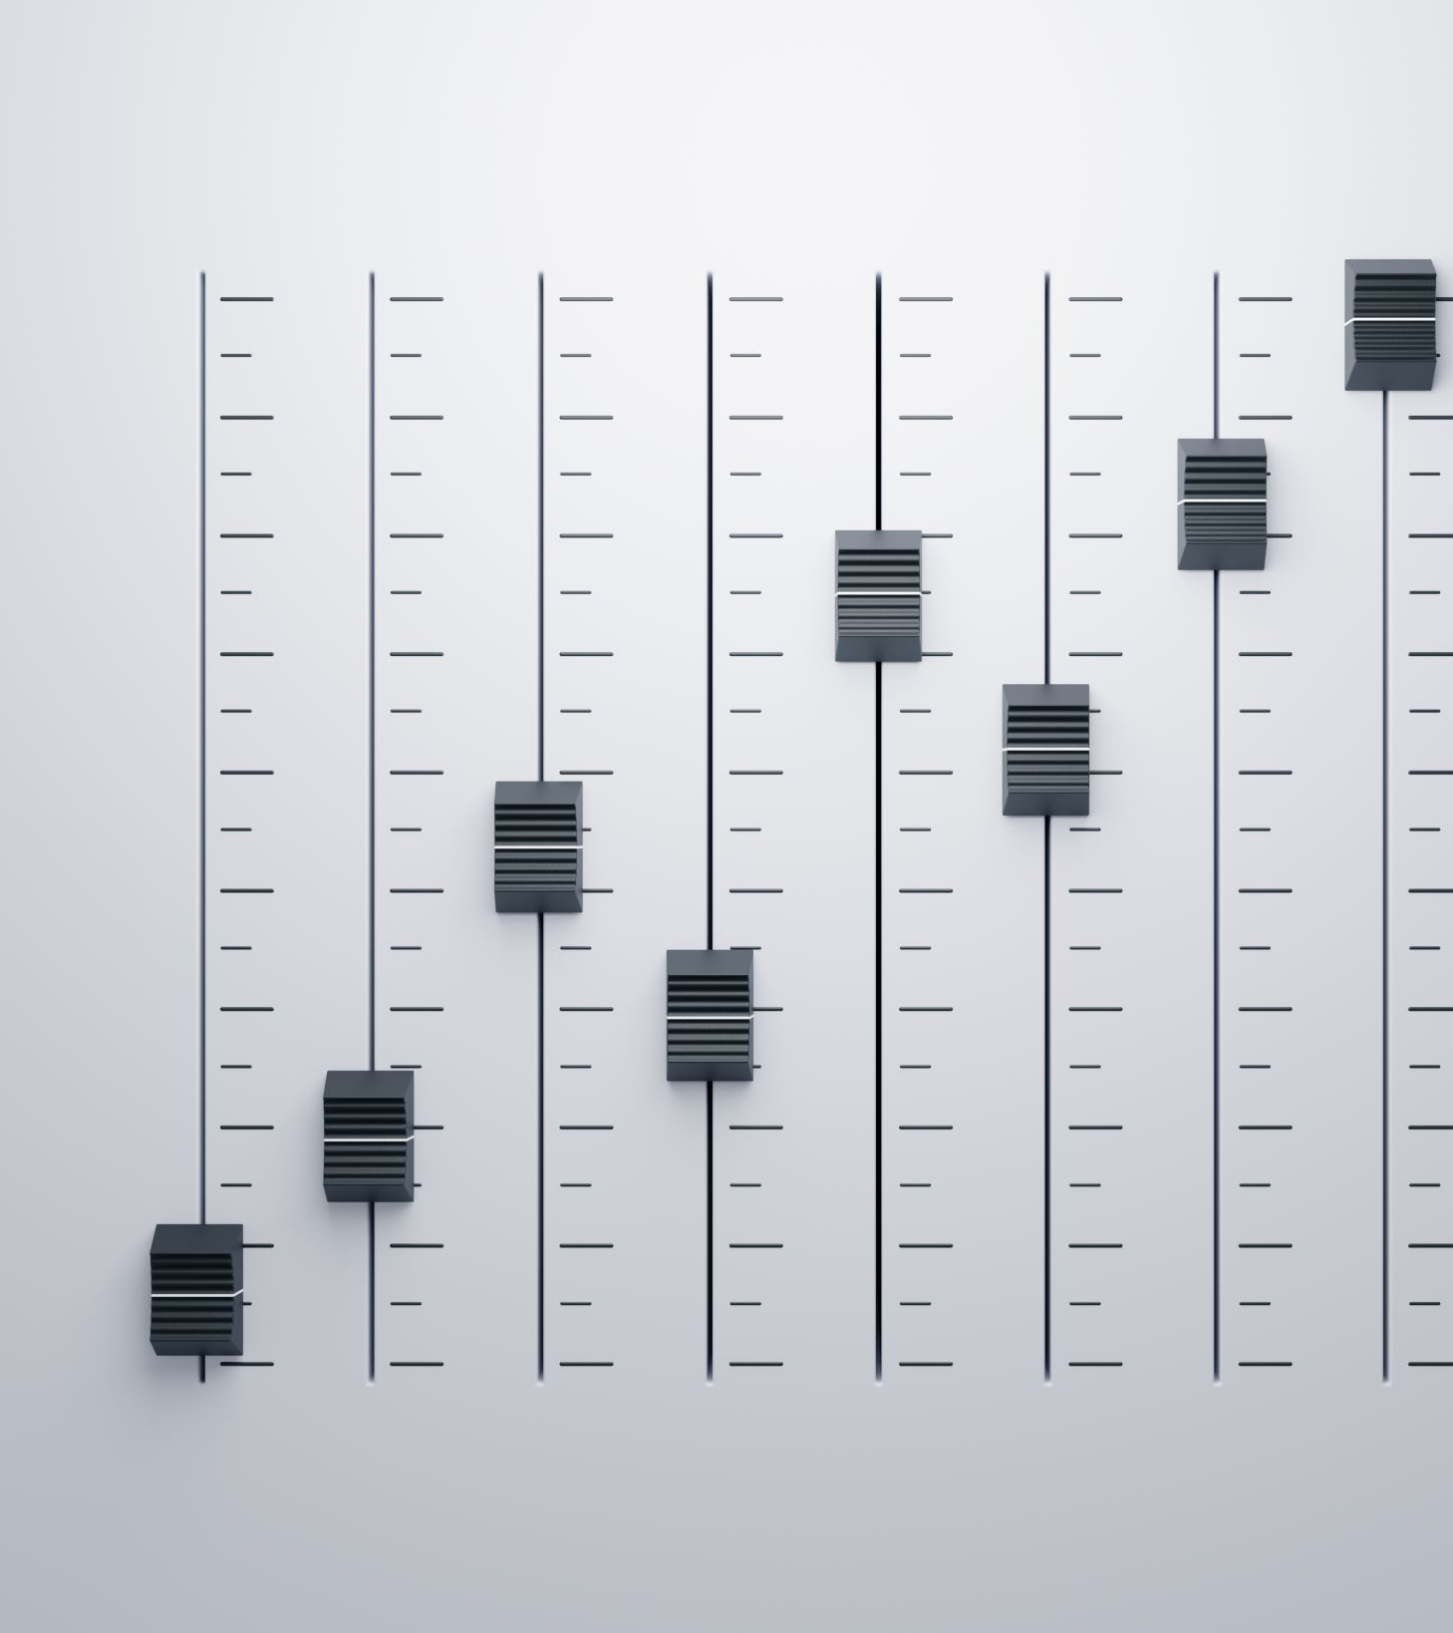
AWGN Channel and Rician Channel
Compare and contrast the BER performance of PSK over a noise limited (AWGN) transmission channel to the performance of PSK over a Rician channel at 5- and 10-dB Signal to Noise Ratio (E_{b}/N₀), respectively.
Is there a significant difference in BER performance of PSK between the AWGN channel and Rician channel?
Answer: Yes, there is a significant difference in the Bit Error Rate (BER) performance of Phase Shift Keying (PSK) between the AWGN (Additive White Gaussian Noise) channel and the Rician fading channel. The main differences stem from the nature of these channels and how they affect the transmitted signal.

Slide 29

CONCLUSION
In Conclusion, The slides you have seen demonstrates the knowledge I’ve picked up from this course. It goes on to show the hard work and work ethic I’ve put into these previous projects. And shows the errors and mistakes I’ve made during the time and how I’ve learned & grew from those mistakes. It shows how during the weeks 1-8 I was able to expand my knowledge on Spectrum Analyzer and other important aspects that plays a part in perusing a career in Electrical engineering.

