Slide 1

MODULE 8 FINAL PROJECT
BY:Robert WILKINS

Slide 2
INTRODUCTION
IN This project you will see the steps and challenges I’ve faced through out this course. Furthermore, you’ll see my thought process and the new things I’ve learned or picked up along the way. This is the final project that’ll be done for this course enjoy!

Slide 3

Challenges Slide
Some challenges I’ve faced in this project was getting the right materials. Sometimes I’d forget about things or ill forget the due date to the assignment. Trying to maintain a stable Wi-Fi to finish the projects. I've recently been having trouble keeping a good Wi-Fi signal. I had to buy a new router and hope that it fixes my issue. Trying to make sure the work was done on time has been a real challenge for me lately.

Slide 4
SEC285
Module 3
Stateful Firewall

Slide 5
Activity | Requirement(s) | Points
Question | Answer | 30
Nmap Scan | Screenshot | 30
Rubric

Slide 6

Question
What effect does the sudo iptables --policy INPUT DROP command have on the access to computing resources?
Answer here:
The sudo iptables – policy INPUT DROP command sets the default policy for incoming traffic to DROP. This means that by default, all incoming traffic to the system will be denied, unless specific rules are added to allow it. It also enhances security by effectively closing off incoming communication unless explicitly allowed through iptables rules.
References:

Slide 7
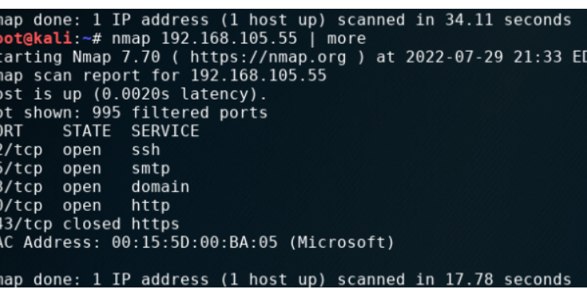
Nmap Scan
This screenshot should show the Nmap scan result of the Linux Server VM.

Slide 8
SEC285
Module 4
Bring Your Own Device (BYOD)
Security Policy

Slide 9
Rubric
Activity | Requirement(s) | Points
BYOD Security Policy | The complete policy template | 60

Slide 10

Overview:
Tablets, smartphones, and laptops are incredibly widely used in modern enterprises due to their versatility, portability, and productivity-enhancing capabilities. These devices allow employees to work remotely, access corporate data and applications on the go. Some threats that are associated to these devices are Data breaches, malware and viruses, phising attacks ,unauthorized access ,data leakage and Device theft or Loss.
2. Purpose:
Timely discovery of Bring your own Device security policy vulnerabilities is crucial for reducing the attack vector on an organization’s computing resource. This helps Rapid response ,Patch management , Enhanced Monitoring ,User Education & Awareness , Policy Review & Update , and Reduced Exposure .

Slide 11

3. Scope:
There's a variety of attacks that threaten these devices such as a Phishing attack. This attack target mobile devices and has become increasingly sophisticated. Employees may receive fake emails , text messages , or social media messages designed to trick them into revealing sensitive information or installing malware.
4. Policy:
BYOD security policy enhances security posture and reducing the attack vector on an organization’s computing resources . By staying vigilant , implementing effective security awareness, organizations can better protect themselves against evolving cybersecurity threats in an increasingly connected and mobile world.

Slide 12

5. Policy Compliance:
Employees who don’t follow security policy will start off with a Warning or Reprimand , Loss of privilege ,training requirements Disciplinary Action , Legal Ramifications , Loss of Trust.
6. Related Standards, Policies, and Processes:
HIPPAA standards refer to regulations and requirements outlined in the health Insurance Portability and Accountability Act of 1966. HIPAA is a federal law in the United States that sets standards for the protection of sensitive patient health information, known as Protected Health Information (PHI).

Slide 13
7. Definitions and Terms:
[Please remove after completion: Think of terms such as BYOD, mobile devices, and CIA. Define them here]
8. Revision History:
Date of change | Responsible | Summary of change
August 2019 | SANS policy team | Updated and converted to new format
January 2024 | Robert Wilkins | filled out questions 1-8

Slide 14
SEC285
Module 5
Multifactor Authentication (MFA)

Slide 15
Rubric
Activity | Requirement(s) | Points
Common-auth Configuration File | Screenshot | 30
MFA Logon Screen | Screenshot | 30

Slide 16
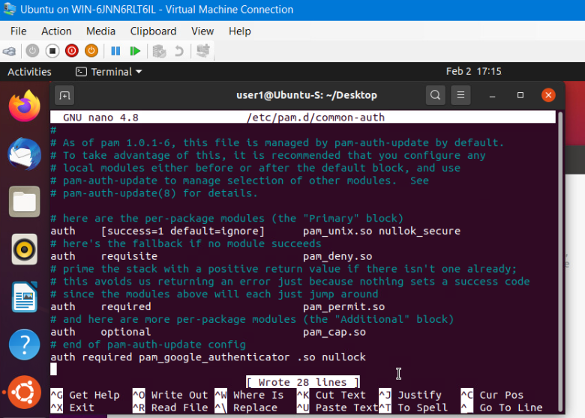
Common-auth Configuration File
This screenshot should show the entry that indicates the use of the Google Authenticator module.

Slide 17
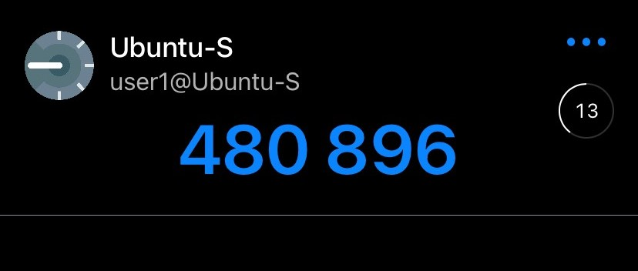
MFA Logon Screen
This screenshot should show the logon screen where a verification code is required.

Slide 18
SEC285
Module 6
Vulnerability Assessment

Slide 19
Rubric
Activity | Requirement(s) | Points
Nmap | Screenshot | 15
NetCat | Screenshot | 15
Wireshark | Screenshot | 15
Nessus | Screenshot | 15

Slide 20
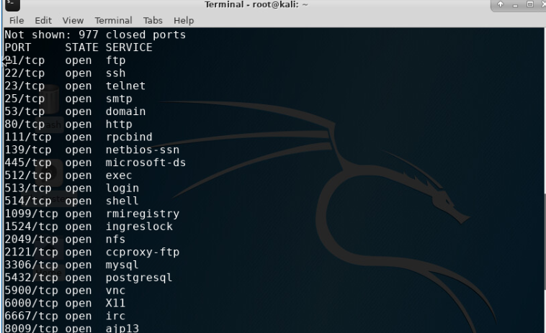
Nmap
This screenshot should include the scan result showing both the Kali and Linux Server VMs.

Slide 21
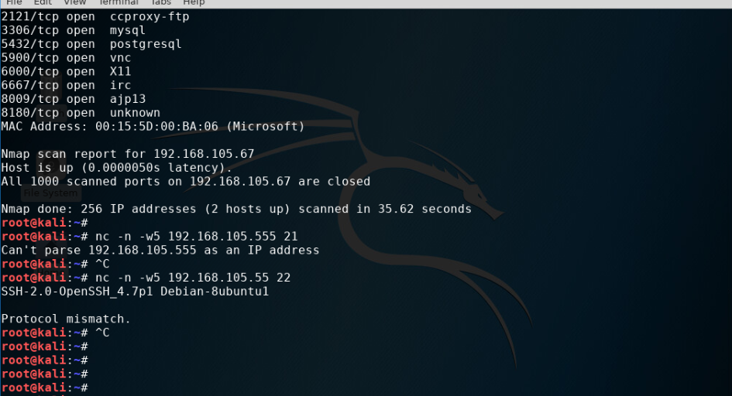
NetCat
This screenshot should include the scan result showing both the Kali and Linux Server VMs.

Slide 22

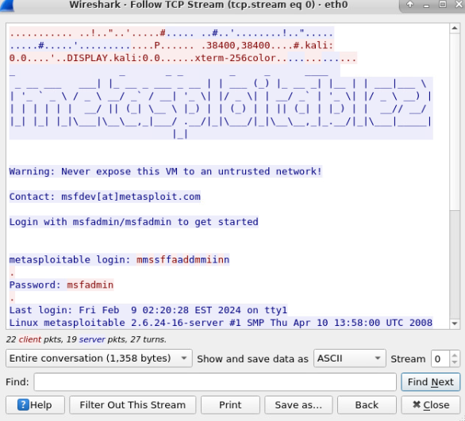
Wireshark
This screenshot should include the Wireshark—Follow TCP Steam window showing the Telnet username and password.

Slide 23
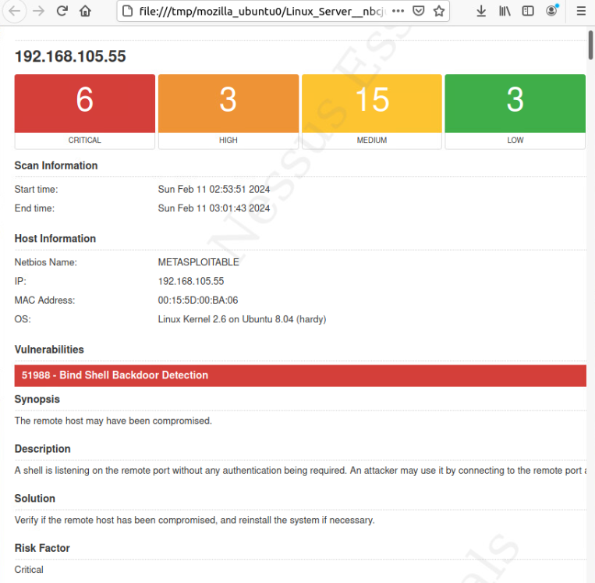
Nessus
This screenshot should include the high-level view of the Nessus vulnerability scan report (showing categories of vulnerability in different colors).

Slide 24
References
How To Become an Electrical Engineering Technician (A Step by Step Guide) (owlguru.com)
What Is an Electrical Engineering Technician? (With Duties) | Indeed.com

Slide 25
CONCLUSION
In conclusion I learned how to:
Identify social engineering attacks.
Differentiate cryptographic algorithms and their applications.
Survey network security devices and protocols.
Explain wireless network security solutions.
Interpret application security, device security, and physical security.
Examine authentication and access control techniques.
Assess business continuity and risk management strategies.
Explore the evolving job market in the digitized world.
Produce a secure network.
This has been a great and important lesson for me in boosting my knowledge and expand my horizon even more in my career path for engineering.

Slide 26
Career Skill
For my Career path “Electrical Engineering “ these are the requirements:
Skills:
Knowledge skills:
1. | Critical Thinking
2. | Reading Comprehension
3. | Active Listening
4. | Complex Problem Solving
5. | Monitoring
1. | Computers and Electronics
2. | Engineering and Technology
3. | English Language
4. | Mathematics
5. | Production and Processing

